Slide 1


SAP S/4HANA CDS, BTP Full Stack Training Day 7
Anubhav Oberoy

Slide 2

Day 7
IDoc List Report Application
Introduction to RAP
Why we need frameworks
What is Restful Application Programming Model
RAP Scenarios
Flight Data Model
Notes:
https://unsplash.com/photos/CPs2X8JYmS8

Slide 3




Challenges in ABAP development
UI
Common needs
Create application logic
Insert, update, delete, validate, select data
Perform validations
Check customizing
Handle locks
Create A/c documents
Manage Documents
Application Code
I, U, D, S, V
Search Documents
Validate before save
Alex, ABAP Developer,
SAP FICO
UI
Challenges
Thinks differently
Adapt application code
High maintenance
No standardization
Different coding practices
Lack of standard
Create Sales Orders
Manage Sales Orders
Application Code
I, U, D, S, V
Search/Filter Sales Order
Compute Sales total
Stella, ABAP Developer,
SAP SD
Trainer: Anubhav Oberoy

Slide 4
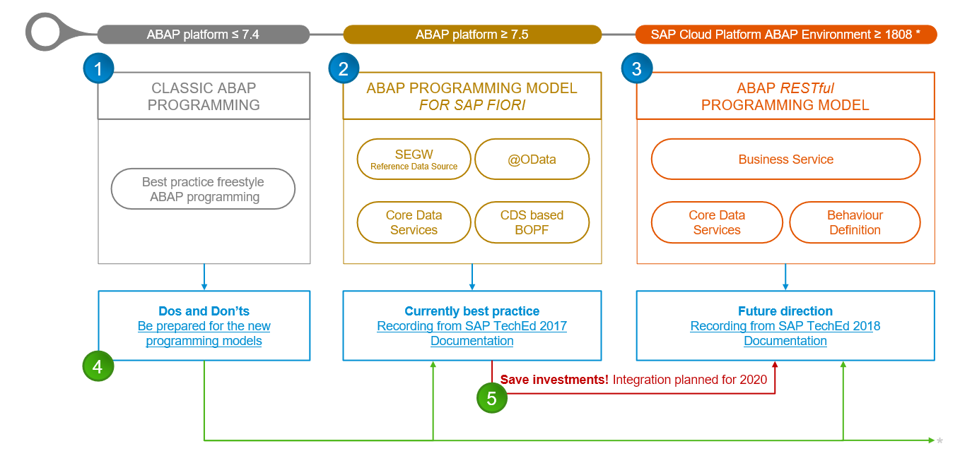
Evolution of ABAP Programming Model

Slide 5
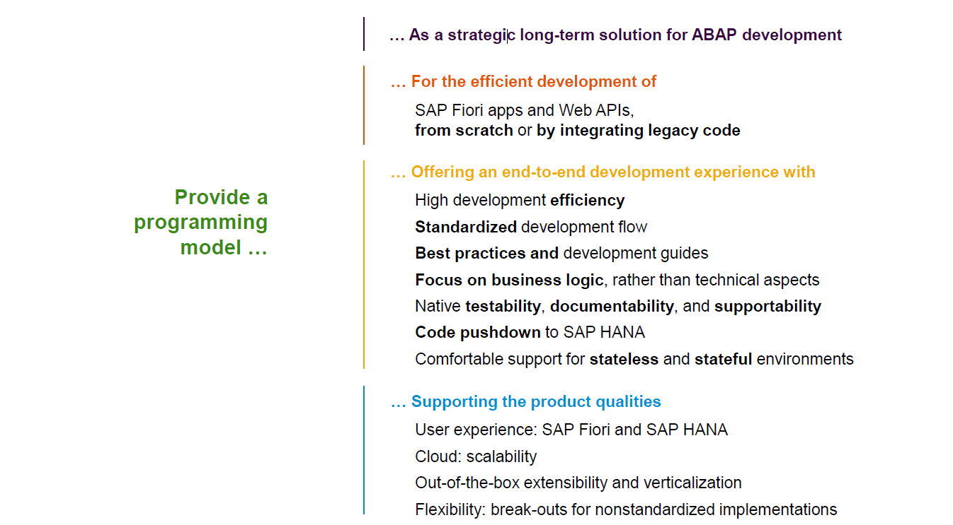
Restful ABAP Programming

Slide 6
Restful ABAP Programming
The ABAP RESTful programming model defines the architecture for efficient end-to-end development of intrinsically SAP HANA-optimized OData services (such as Fiori apps) in SAP Business Technology Platform ABAP Environment. It supports the development of all types of Fiori applications as well as A2X services. It is based on technologies and frameworks such as Core Data Services (CDS) for defining semantically rich data models and a service model infrastructure for creating OData services with bindings to an OData protocol and ABAP-based application services for custom logic and SAPUI5-based user interfaces .
The whole architecture is based on
CDS views – will helps you to create semantically rich data model.
Business Object here is a node inside a tree data structure which is achieved by using root keyword at CDS view level, this is needed only if we want to add transactional capability.
Finally create a service using service definition and service binding .
The binding will confirm the Purpose of service – API or Fiori.
UI layer with the Fiori app using elements.

Slide 7

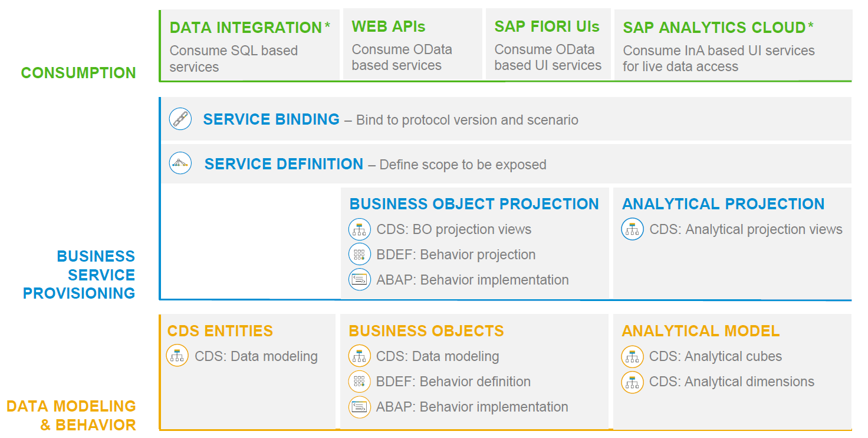
RAP – The Big picture

Slide 8
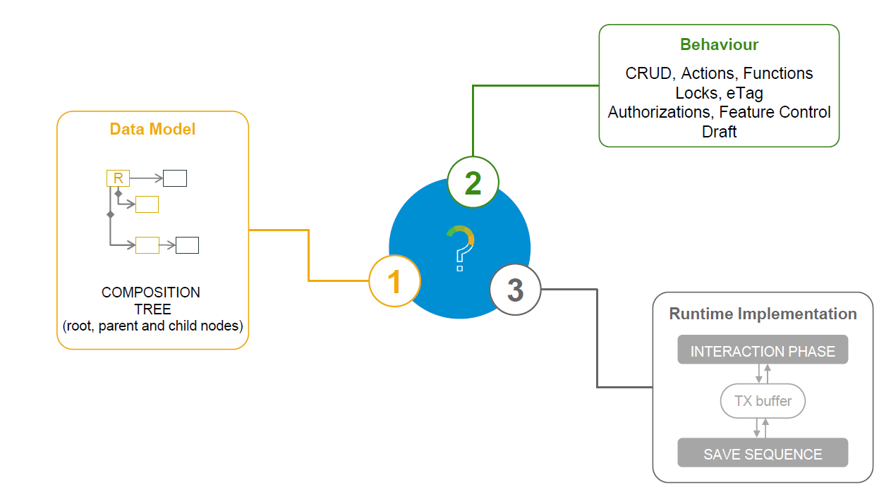
What is a Business Object

Slide 9
Types of Implementation (Scenario)
Brownfield Implementation
Is used when we want to create a transactional application which can insert, update, delete data from the system by writing your own logic
You already have Business logic with you and you want to use that business logic to perform transactional capability
You are own your own to manage your implementation.
02. Managed Scenario
Greenfield Implementation
Is used when we want to create a transactional application which can insert, update, delete data from the system by using the framework provided implementation
You do not have Business logic with you and you want system to create business logic for you automatically.
01. Un-Managed Scenario

Slide 10
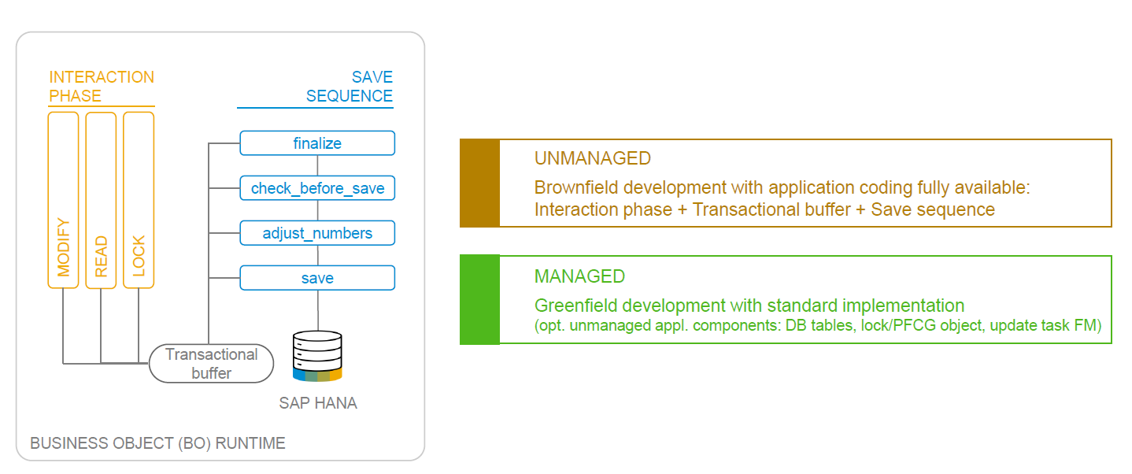
BO runtime implementation types

Slide 11
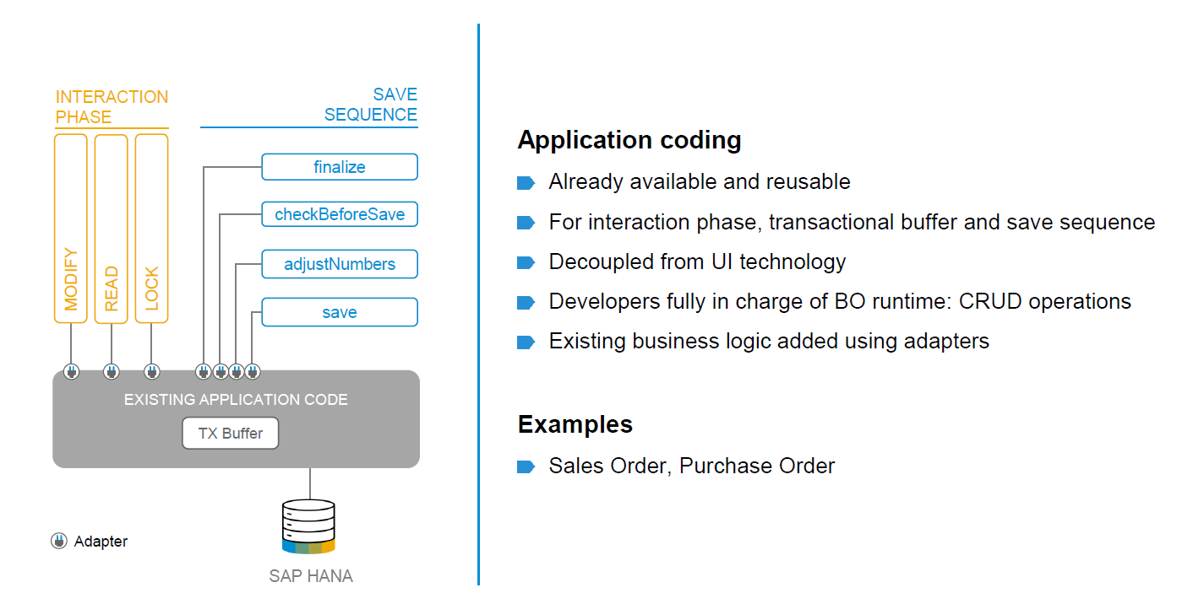
BO runtime implementation types

Slide 12

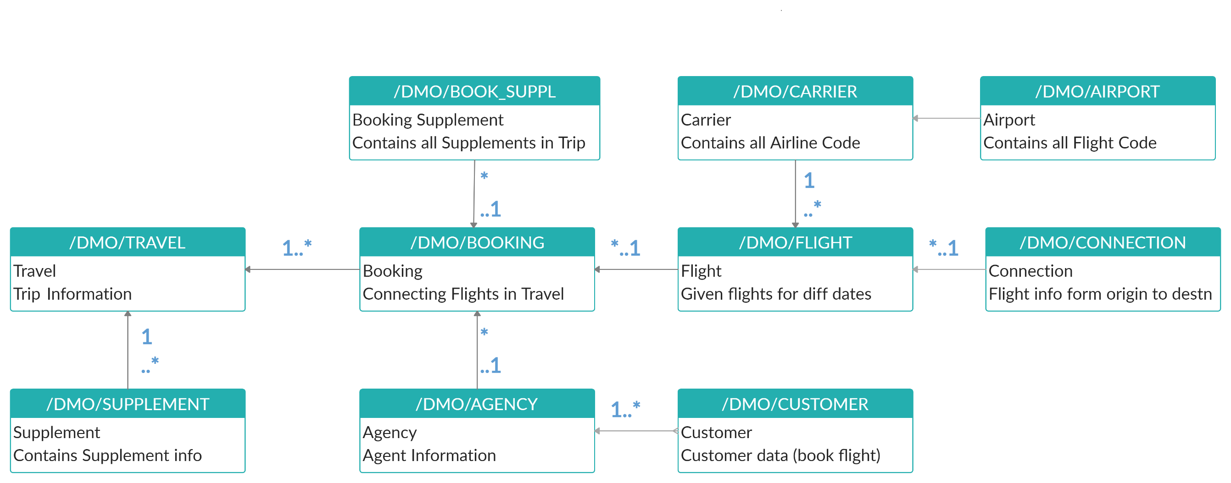
Explanation of Flight Data Model
If Data is not found in these Table’s please execute Data Generator Class “/dmo/cl_flight_data_generator”

Slide 13
Flow of Development (Unmanaged Scenario)
Fiori UI
Service Binding for UI
Service Definition
Travel – Using /demo/travel
Projection view- what we want to show to UI
1
N
I_Currency
1
N
N
Agency
Customers
I_Country

Slide 14
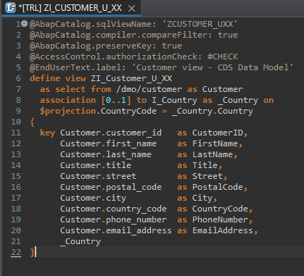
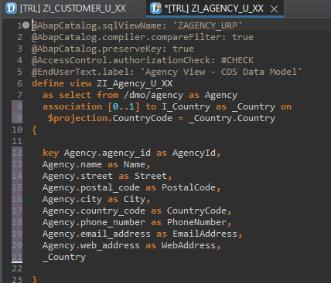
Defining Data Models
Defining Data Models
Create Customer CDS View “ZI_Customer_U_XX”
Create Agency CDS View “ZI_Agency_U_XX”

Slide 15
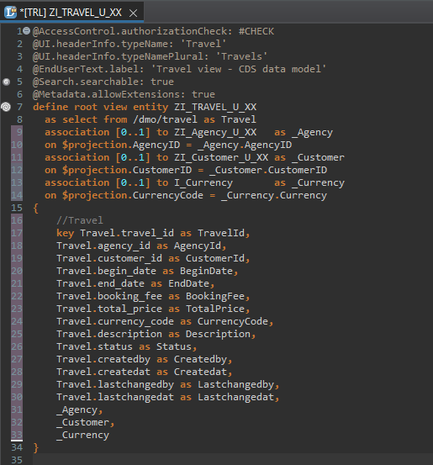
Root CDS Entity
Root CDS Entity
On top of Customer and Agency CDS View we Create Root CDS View Entity called “ZI_TRAVEL_U_XX”.
With Annotations like Metadata ,Search ,
Semantic Annotation etc.
Association to Agency ,Customer , Currency.

Slide 16
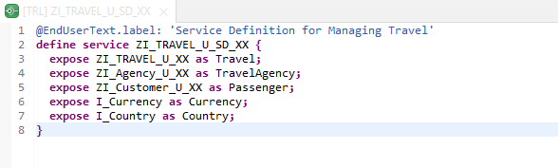
Create OData Service ( Business Service )
Create OData Service ( Business Service )
A business service definition (short form: service definition) describes which CDS entities of a data model are to be exposed so that a specific business service, for example, Sales Order handling, can be enabled. It is an ABAP Repository object that describes the consumer-specific but protocol-agnostic perspective on a data model. “ZI_TRAVEL_U_SD_XX”
CDS Entity
Service Definition
Service Binding

Slide 17
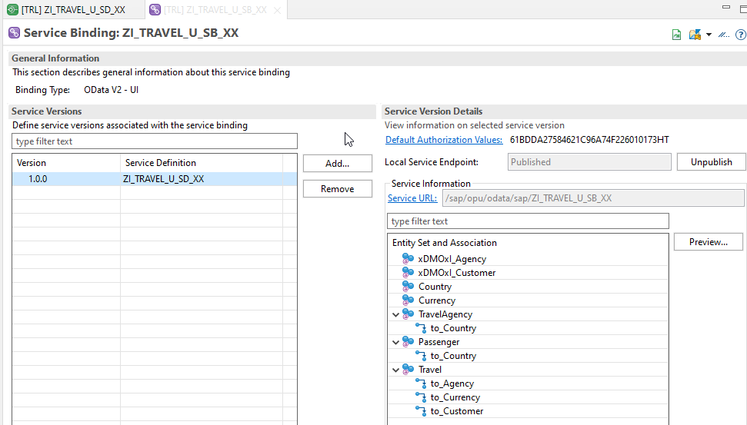
Service Binding ( Business Service )
Service Binding ( Business Service )
The business service binding (short form: service binding) is an ABAP Repository object used to bind a service definition to a client-server communication protocol such as OData. Like any other repository object, the service binding uses the proven infrastructure of the ABAP Workbench, including the transport functionality

Slide 18



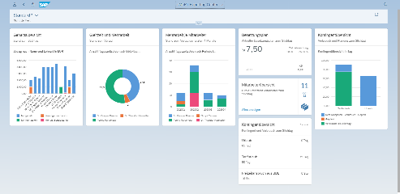





Developer Persona – Fiori Elements
Anubhav
Happy User
Rob
S/4HANA Technical consultant
ABAP Developer
Roxana
UX Designer | Fiori Developer
ABAP Dev. Tools
On
Eclipse
VS Code
BAS
OData Service
Fiori Elements Project
Annotations.xml
CDS Views
MDE
@
www.anubhavtrainings.com

Slide 19
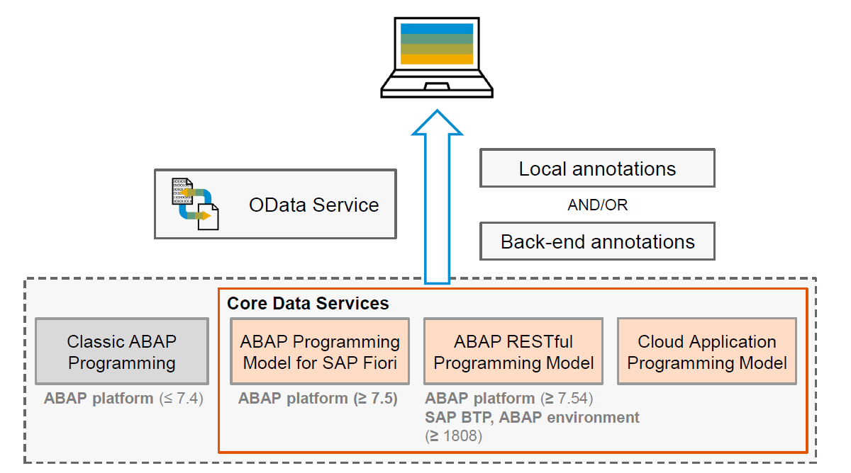
Big Picture – Architecture
www.anubhavtrainings.com

Slide 20
Metadata extension
When we develop CDS views, we can put many annotations inside CDS. But when we looking forward to develop a UI application, we want @UI annotations. By putting these UI annotations directly inside CDS, we are talking risk.

Slide 21
Fiori Elements - List Report Application
The list report offers powerful features for finding and acting on relevant data sets. It is often used as an entry point for navigating to the item details, which are usually shown on an object page.
List Report
Object Page
www.anubhavtrainings.com

Slide 22
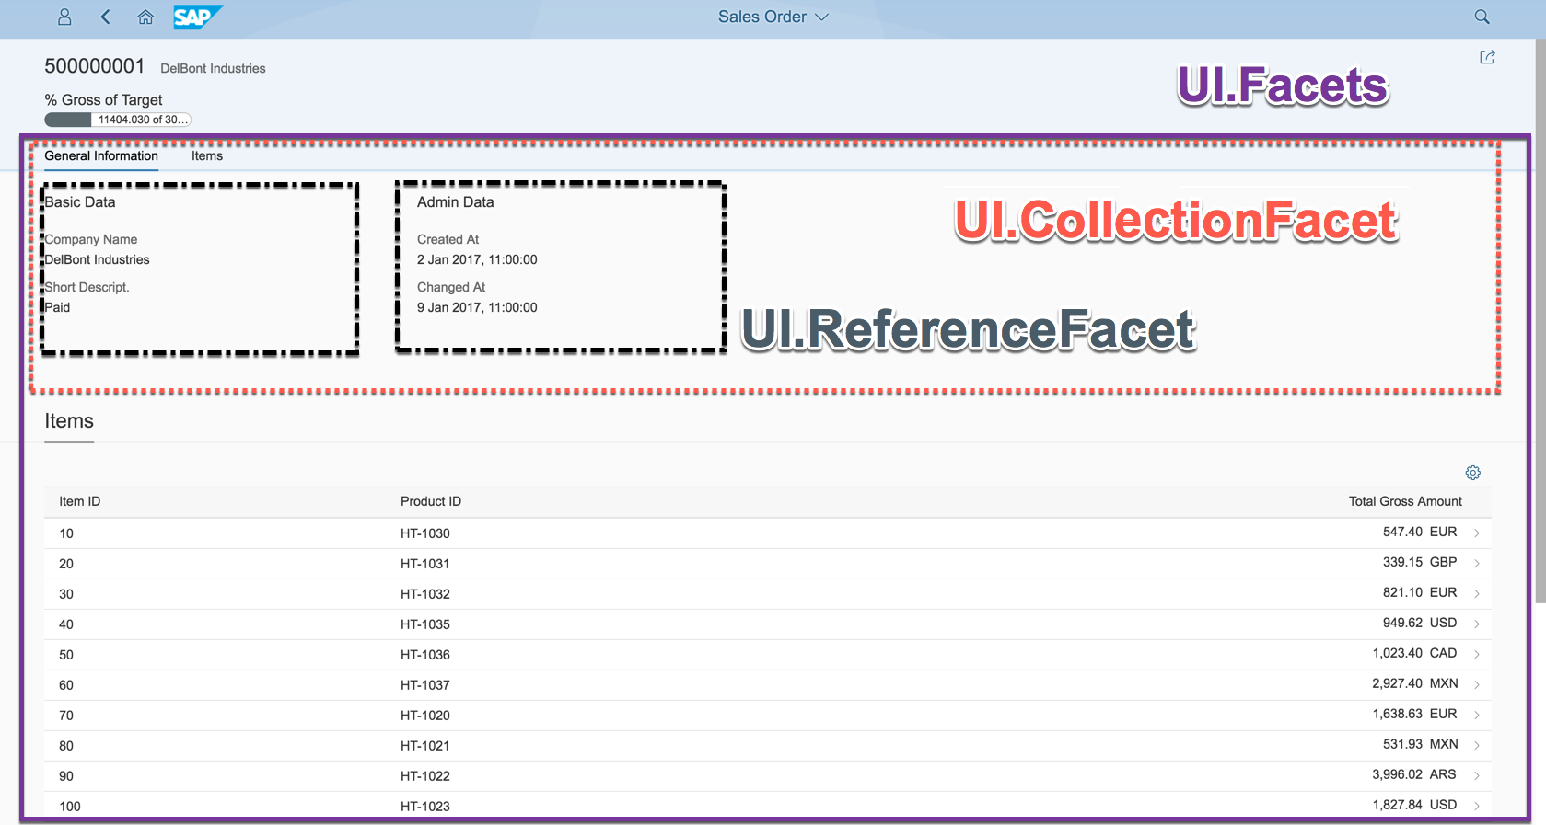
Object Page
www.anubhavtrainings.com

Slide 23
Developing Read only List Report
UI Annotations
@UI.selectionField – Bring a filter field on smart filter bar
@UI.lineItem – enable us to put a column inside the smart table, position, label
@UI.identification – used create fields in Object page
@Semantics.amount.currencyCode – mark the unit of amount field
@UI.headerInfo.typeName – Label for displaying single record
@UI.headerInfo.typeNamePlural – Table Label
@UI.facet: [{purpose : #STANDARD – This will create a section inside the object page
type: #IDENTIFICTION_REFERENCE – What type of data you want to display}]
Metadata Extension
MDE file for Travel
Documentation
Documentation Link for ABAP RAP

Slide 24
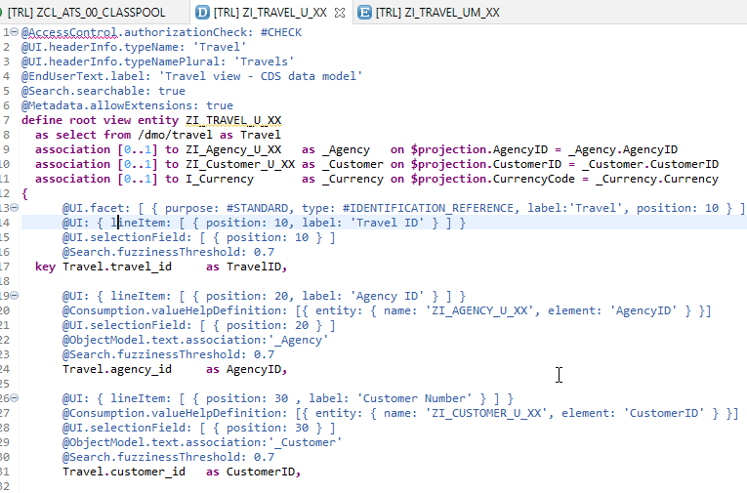
CDS Views with Annotations
Exercise
ZI_TRAVEL_U_XX ( Travel )

Slide 25

Title
content
www.anubhavtrainings.com

Slide 26
Title
content
www.anubhavtrainings.com

Slide 27

Questions?

Slide 28

Thank you
Anubhav.abap@gmail.com
contact@anubhavtrainings.com
+91 84484 54549
www.anubhavtrainings.com

